Slide 1

Django Basic
Django Introduction

Slide 2
Information
Agenda
System
01
Python Overview
Starting with Python in PyCharm
02
HTML in Django
The starting point of Django
03
Basic Template in Django
HTML in Django

Slide 3
Python Overview
Starting with PyCharm

Slide 4
The Python Interpreter
Python is an interpreted language.
Commands are executed through the Python interpreter.
  The interpreter receives a command, evaluates that command, and reports the result of the command.
A programmer defines a series of commands in advance and saves those commands in a text file known as source code or a script.
For Python, source code is conventionally stored in a file named with the .py suffix (e.g., demo.py).

Slide 5
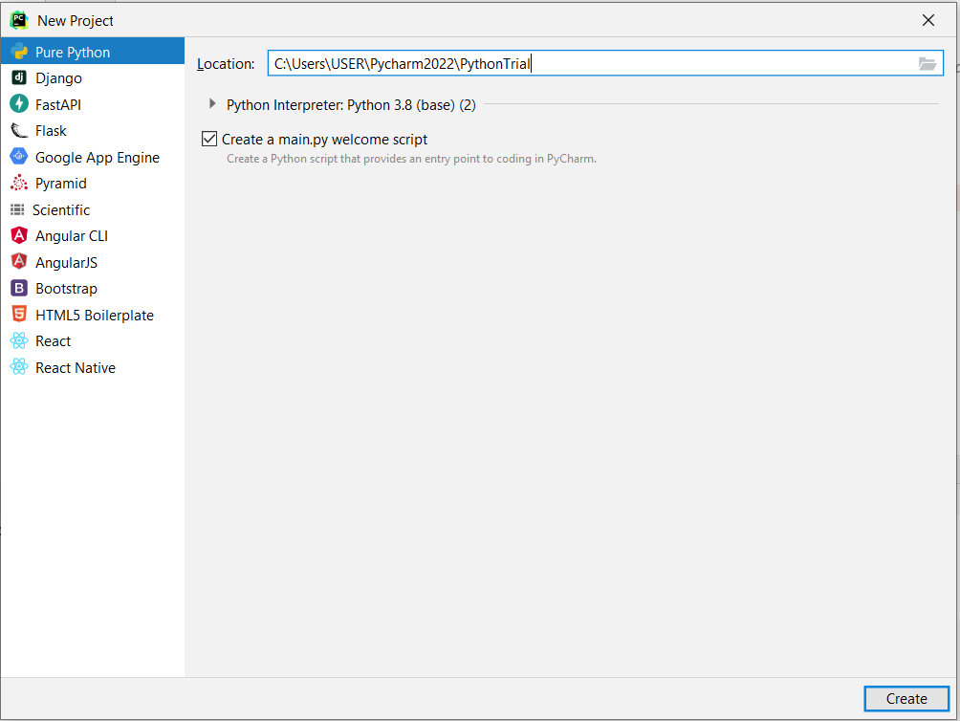
First Project
PyCharm provides a lot of built-in projects. One of them is Django.
For preliminary, we will build “Pure Python”
Let’s create a project named “PythonTrial”

Slide 6
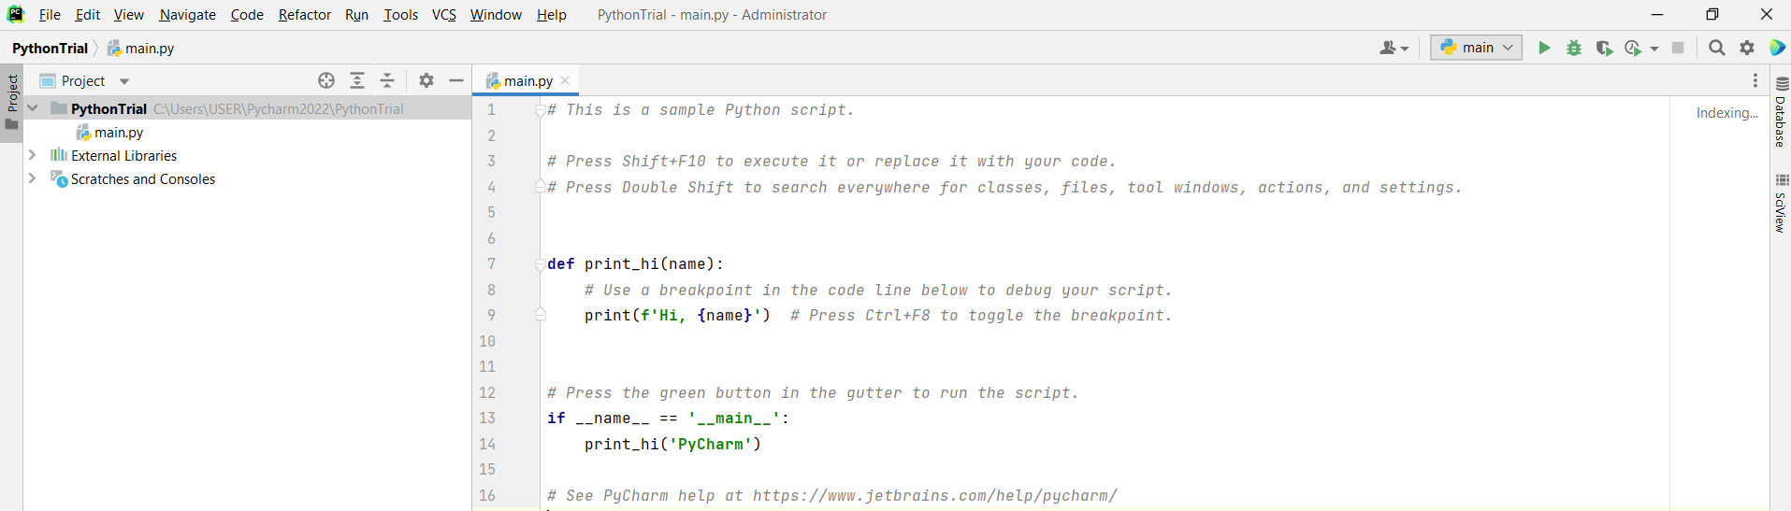
First Project
A file “main.py” is created.
The contents contain 1 function (print_hi) with one parameter and one main method.

Slide 7
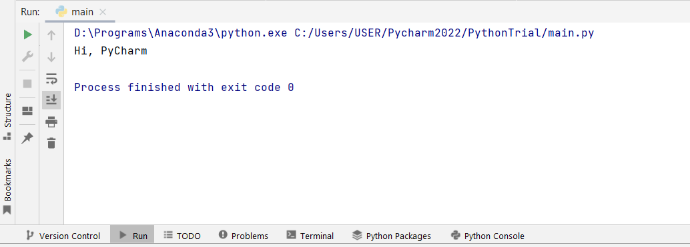
First Project
To execute the project, press the “run” button
Or, you can press Shift + F10.
Output

Slide 8
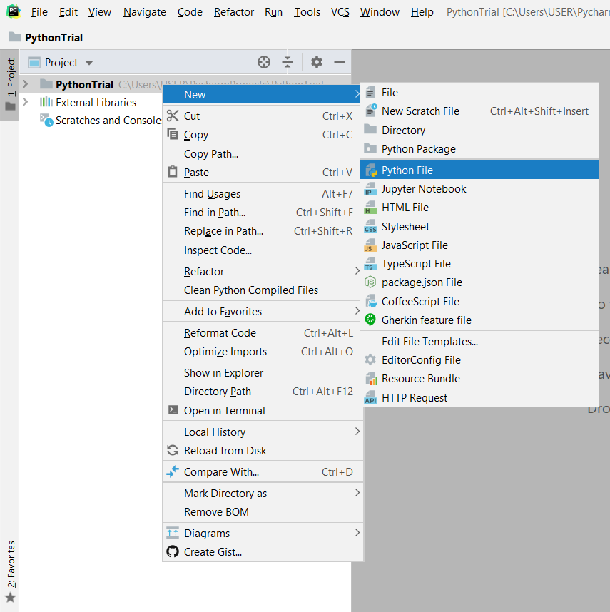
First Project
Inside the Project, you can create a python file.
Do click on the right mouse button and create new “Python File”

Slide 9
Hello World
The starting point of any programming language is Hello World
Printing multiple values can be separated by comma
If it does not contain “main” method, you need to choose “run” manually.
To execute (run) the file, press Ctrl+Shift+F10
print("Hello World")
print("Hello World", 5)

Slide 10
Objects in Python
Python is an object-oriented language and classes form the basis for all data types.
Python’s built-in classes:
  the int class for integers,
  the float class for floating-point values,
  the str class for character strings.

Slide 11
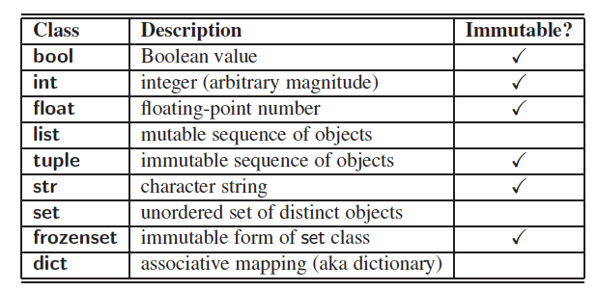
Built-In Classes
A class is immutable if each object of that class has a fixed value upon instantiation that cannot subsequently be changed. For example, the float class is immutable.

Slide 12
The bool, int, and float Class
bool
int
float
The bool class is used for logical (Boolean) values, and the only two instances of that class are expressed as the literals: TRUE / FALSE
The int class is designed to represent integer values with arbitrary magnitude.
The float class is the floating-point type in Python.
The constructor float( ) returns 0.0.
The integer constructor, int( ), returns 0 by default.
float(2) returns the floating-point value 2.0
float(‘3.14’) returns 3.14
The default constructor, bool( ), returns False.
int(3.14) produces the value 3, while int(−3.9) produces the value −3.
The constructor can also be used to parse a string that represents an integer. the expression int('137') produces the integer value 137.

Slide 13
The list and tuple Class
list
tuple
A list instance stores a sequence of objects
Elements of a list may be arbitrary objects (including the None object) with length n and indexed from 0 to n-1 inclusive.
Lists have the ability to dynamically expand and contract their capacities as needed.
Python uses the characters [ ] as delimiters for a list literal.
  [ ] is an empty list.
  [‘apple’, ‘grape’, ‘banana’] is a list containing three string instances.
The list( ) constructor produces an empty list by default.
The list constructor will accept any iterable parameter.
  list(‘HUFS’) produces a list of individual characters, [‘H’, ‘U’, ‘F’, ‘S’].
The tuple class provides an immutable (unchangeable) version of a sequence, which allows instances to have an internal representation that may be more streamlined than that of a list. Parentheses delimit a tuple.
  The empty tuple is ()
To express a tuple of length one as a literal, a comma must be placed after the element, but within the parentheses.
  For example, (17,) is a one-element tuple.

Slide 14
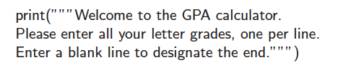
The str Class
String literals can be enclosed in single quotes, as in ‘hello’, or double quotes, as in "hello".
A string can also begin and end with three single or double quotes, if it contains newlines in it.

Slide 15
The set and dict Class
set
dict
Python’s set class represents a set, namely a collection of elements, without duplicates, and without an inherent order to those elements.
Python uses curly braces { and } as delimiters for a set
  For example, as {3} or {‘a’, ‘b’, ‘c’}
  The exception to this rule is that { } does not represent an empty set.
  Instead, the constructor set( ) returns an empty set.
Python’s dict class represents a dictionary, or mapping, from a set of distinct keys to associated values.
Python implements a dict using an almost identical approach to that of a set, but with storage of the associated values.
A nonempty dictionary is expressed using a comma-separated series of key:value pairs.
For example, the dictionary {‘kr’ : ‘Korea’, ‘uk’ : ‘United Kingdom’} maps ‘kr’ to ‘Korea’ and ‘uk’ to ‘United Kingdom’.
Alternatively, the constructor accepts a sequence of key-value pairs as a parameter, as in dict(pairs) with pairs = [(‘kr’, ‘Korea’), (‘uk’, ‘United Kingdom’)].

Slide 16
Program Structure
Common to all control structures, the colon character is used to delimit the beginning of a block of code that acts as a body for a control structure.
If the body can be stated as a single executable statement, it can technically placed on the same line, to the right of the colon.
However, a body is more typically typeset as an indented block starting on the line following the colon.
Python relies on the indentation level to designate the extent of that block of code, or any nested blocks of code within.

Slide 17
Conditionals
IF-THEN
IF THEN ELSE
NESTED IF
A statement with one TRUE condition.
A statement with one TRUE condition and one FALSE condition.
A statement with multiple conditions
if (2<3):
print("2 is less than 3")
a = 5; b = 5
if (a<b):
print("a is less than b")
else:
print("b is less than a")
a = 5; b = 5
if (a<b):
print("a is less than b")
elif (a>b):
print("b is less than a")
else:
print("b equals to a")

Slide 18
Loops
For Loop
While Loop
It does not require an initial value on the iterable variable
If we iterate a sequence number using “range”, we can specify (start:stop:interval) for the iteration.
It requires an initial value on the iterable variables along with action to ensure the iteration.
data = [1,2,3,4,5]
for i in data:
print(i)
j=0
data1= [2,3,4,5,6,7,8]
while j<len(data1):
print(data1[j])
j=j+2
for i in range(3, 12, 2):
print(i)

Slide 19
Break and Continue
Python supports a break statement that immediately terminate a while or for loop when executed within its body.
Python also supports a continue statement that causes the current iteration of a loop body to stop, but with subsequent passes of the loop proceeding as expected.
data = [1, 2, 3, 4, 5]
for number in data:
if number == 3:
break
data = [1, 2, 3, 4, 5]
for number in data:
if number == 3:
continue

Slide 20
Functions
Functions are defined using the keyword def.
A function can be defined without and with parameters.
The number of parameters can be more than one (1).
def display():
print("HUFS")
display()
def display(word):
print(word)
display("Seoul")

Slide 21
Functions
This establishes a new identifier as the name of the function (count, in this example), and it establishes the number of parameters that it expects, which defines the function’s signature.
The return statement returns the value for this function and terminates its processing.
list1 = [1, 2, 3, 4, 5]
def count1(data, target):
n = 0
for number in data:
if number == target:
n +=1
print(n)
count1(list1, 3)
list1 = [1, 2, 3, 4, 5]
def count2(data, target):
n = 0
for number in data:
if number == target:
n +=1
return n
count2(list1, 3)

Slide 22
HTML in Django
Create your first Web

Slide 23
Example
How can you add your HTML file?
For this example, we will simply use HTML tag.

Slide 24
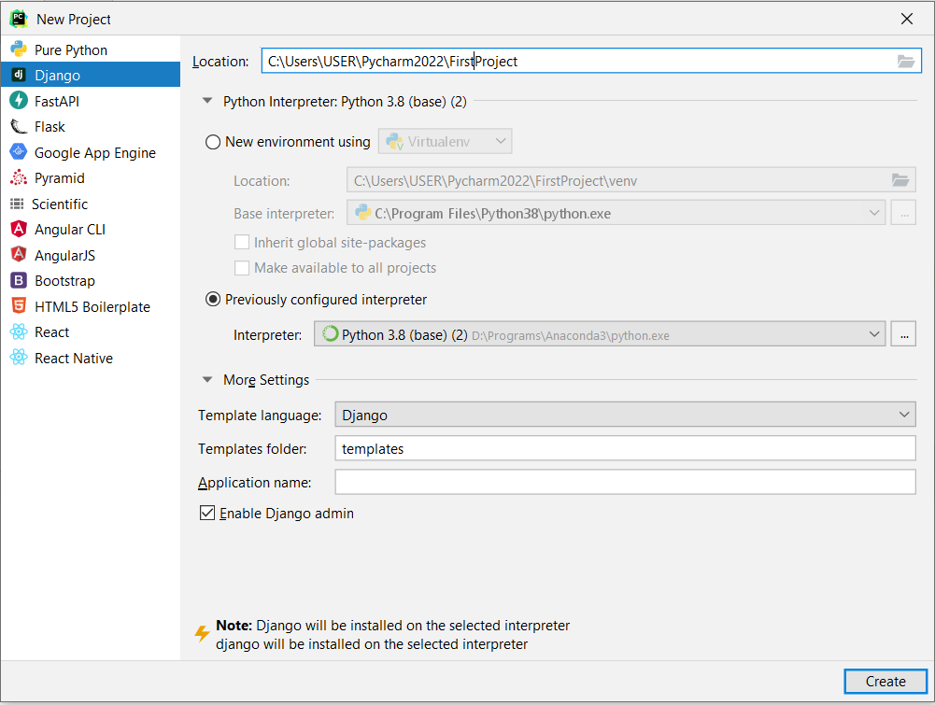
HTML Example
You can use the previous “FirstDjango” Project.
Or, you can create another one

Slide 25
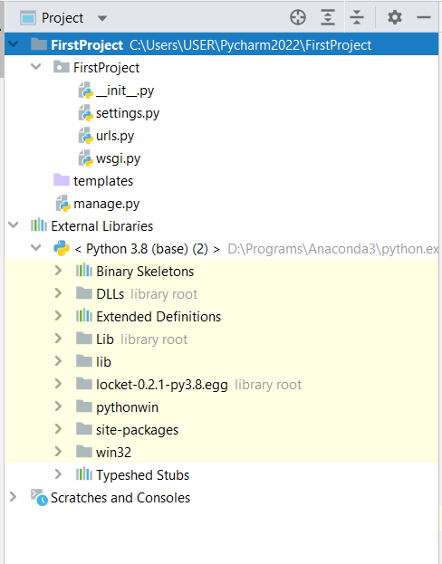
HTML Example
Brief Descriptions
File Name | Descriptions
__init__.py | A constructor that will be blank in the first project
settings.py | A file to manage the configuration of Django
urls.py | A file to manage the URL link
wsgi.py | Web Server Gateway Interface (WSGI) to connect to other platform / server
manage.py | A file to set the Django environment
templates (folder) | A folder to place HTML, CSS, JS files
External libraries | The python interpreter. In other platforms, you need to define virtual environment
URL : uniform resource locator

Slide 26
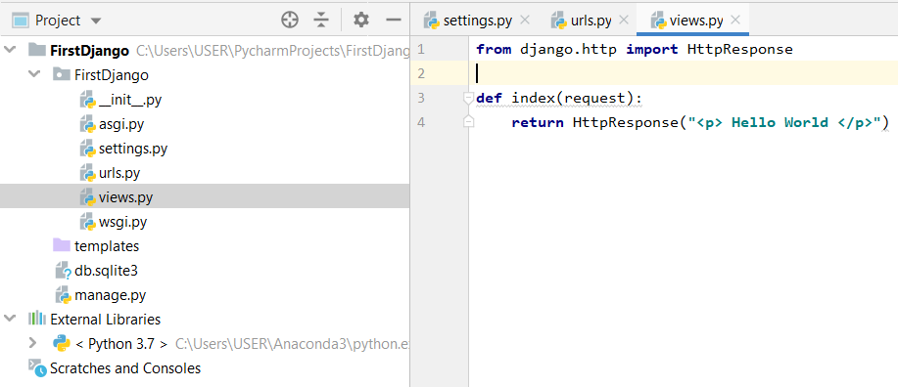
HTML Example
Create a new file “views.py” (to add connection to HTML file)
In the folder “FirstDjango”, do right click on your mouse
Click “New” → “Python File” → type “views.py”
views.py
from django.http import HttpResponse
def index(request):
return HttpResponse("<p> Hello World </p>")

Slide 27
HTML Example
NOTE!
An error in Django 3.1.7 & PyCharm Environment
In settings.py
'DIRS': [BASE_DIR / 'templates']
'DIRS': [BASE_DIR + '/templates']
It means that the folder “templates” will be the place for other relevant files (e.g., HTML, CSS, JS, images, etc.)

Slide 28
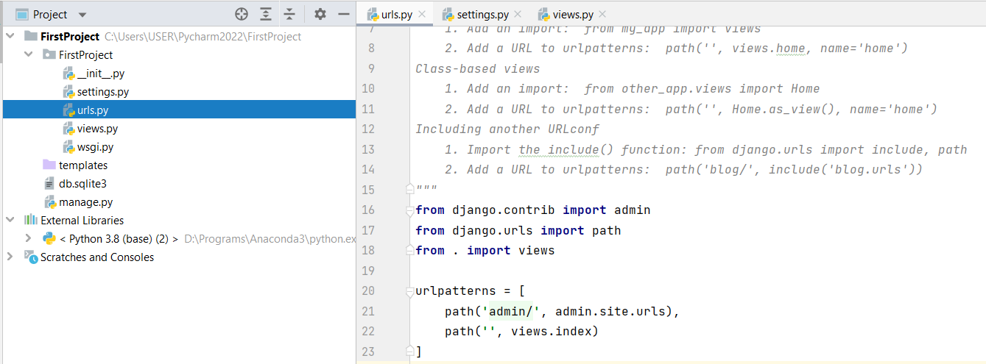
HTML Example
Update the file "urls.py" in the parent (“First Django”) folder
Original code
from django.contrib import admin
from django.urls import path
urlpatterns = [
path('admin/', admin.site.urls),
]
Updated code
from django.contrib import admin
from django.urls import path
from . import views
urlpatterns = [
path('admin/', admin.site.urls),
path('', views.index),
]

Slide 29
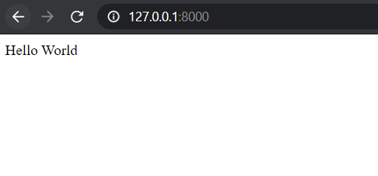
HTML Example
Run Django
http://127.0.0.1:8000/

Slide 30
Next example
How can you add your HTML file?
For the third example, we will use HTML file.
For this chapter, we will learn three steps:
  Add / Modify “views.py”
  Add / Modify “urls.py”
  Add / Modify HTML files
The “views.py” and “urls.py” can be located in the project folder or a new (app) folder
Before you start with this example, delete “views.py” in the parent folder.

Slide 31
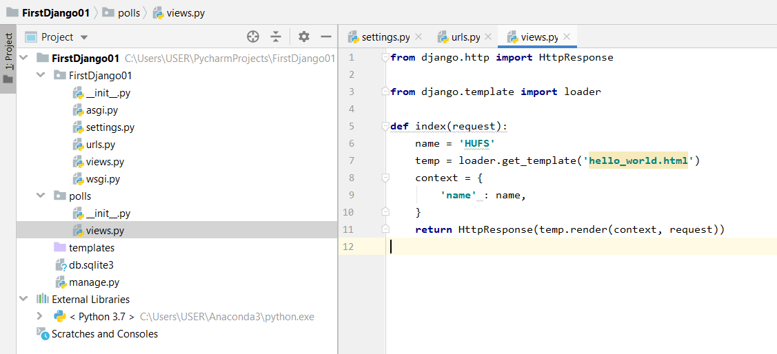
Next example
views.py
urls.py
HTML
Create a new file folder (Python Package) “polls”
Create a new file “views.py” in folder “polls”
views.py
from django.http import HttpResponse
from django.template import loader
def index(request):
name = 'HUFS'
temp = loader.get_template('hello_world.html')
context = {
'name' : name,
}
return HttpResponse(temp.render(context, request))

Slide 32
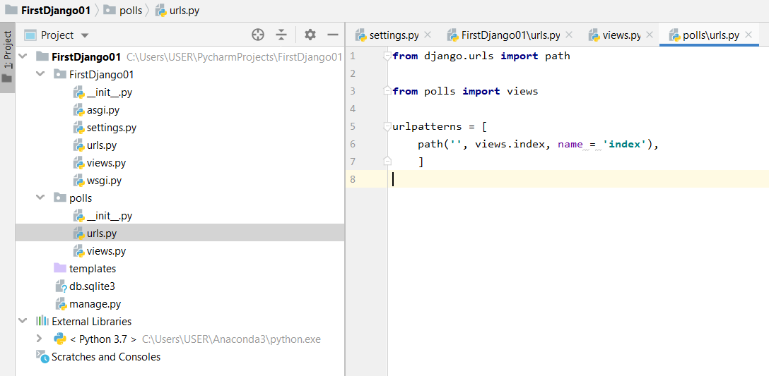
Next example
views.py
urls.py
HTML
Create a new file “urls.py” in folder “polls”
urls.py
from django.urls import path
from polls import views
urlpatterns = [
path('', views.index, name = 'index'),
]

Slide 33
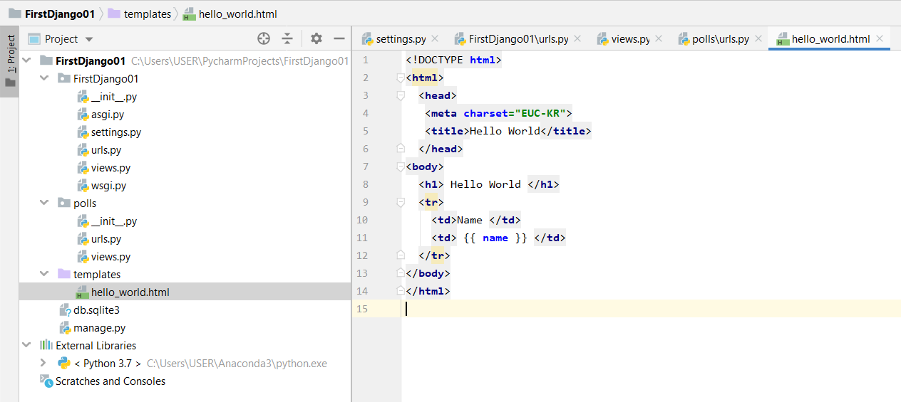
Next example
views.py
urls.py
HTML
Create a new file “hello_world.html” in folder “templates”
hello_world.html
<!DOCTYPE html>
<html>
<head>
<meta charset="EUC-KR">
<title>Hello World</title>
</head>
<body>
<h1> Hello World </h1>
<tr>
<td>Name </td>
<td> {{ name }} {# This is a comment #} </td>
</tr>
</body>
</html>

Slide 34
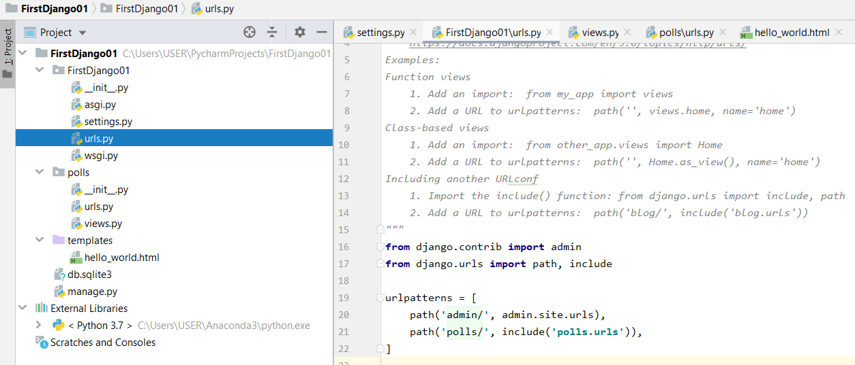
Next example
views.py
urls.py
HTML
In the parent folder
Update the file "urls.py" in the parent (“First Django”) folder
Updated code
from django.contrib import admin
from django.urls import path, include
urlpatterns = [
path('admin/', admin.site.urls),
path('polls/', include('polls.urls')),
]

Slide 35
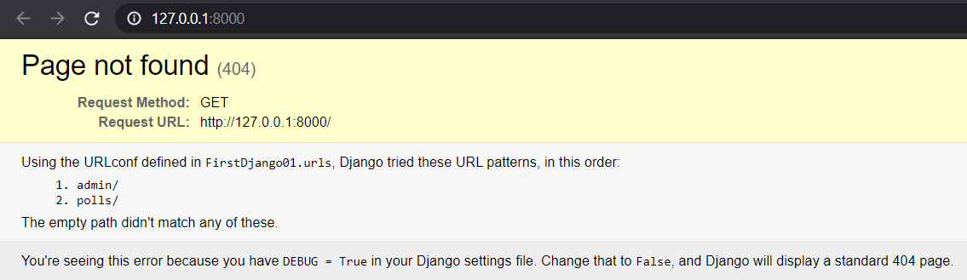
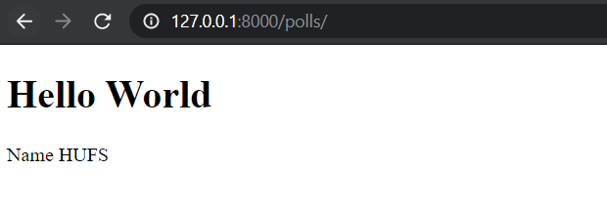
Next example
Run Django
http://127.0.0.1:8000/
http://127.0.0.1:8000/polls/
The link to the index has been deleted
To run the HTML file, use the link “polls”

Slide 36
Template Tag ({{ }})
The {{ }} tag parse (send) the variable from the Python file to the Web.
def index(request):
name = 'HUFS'
temp = loader.get_template('hello_world.html')
context = {
'name' : name,
}
return HttpResponse(temp.render(context, request))
<h1> Hello World </h1>
<tr>
<td>Name </td>
<td> {{ name }} {# This is a comment #} </td>
</tr>

Slide 37
Comments
Just as in HTML or in a programming language such as Python, the Django template language allows for comments. To designate a comment, use {# #}:
The comment will not be output when the template is rendered. A comment cannot span multiple lines. This limitation improves template parsing performance.
In the following template, the rendered output will look exactly the same as the template (i.e., the comment tag will not be parsed as a comment):
{# This is a comment #}
This is a {# this is not
a comment #}
test.

Slide 38
Template Tags
Tags in Django

Slide 39
Template Tag
The template system ships with built-in tags.
  if/else
  for
  ifequal/ifnotequal

Slide 40
Template Tag (if/else)
if/else
The {% if %} tag evaluates a variable, and if that variable is “true” (i.e., it exists, is not empty, and is not a false Boolean value), the system will display everything between {% if %} and {% endif %}, for example:
An {% else %} tag is optional:
{% if today_is_weekend %}
<p>Welcome to the weekend!</p>
{% else %}
<p>Get back to work.</p>
{% endif %}
{% if today_is_weekend %}
<p>Welcome to the weekend!</p>
{% endif %}

Slide 41
IF/ELSE Example
views.py
urls.py
HTML
Add a function "if_else" in the "views.py" in the folder "polls".
In this function, a variable "warr" is initialized as "True". Next, we have two additional variables vara and varb.
Again, we use get_template function to call the HTML file for this function.
The context is declared (context1) and we send "warranty" to HTML file with a value of "war".
In the last rows, we render the template with the defined context1.
def if_else(request):
warr = True
vara = 8
varb = 5
temp = loader.get_template('hello_if.html')
context1 = {
'warranty' : warr,
'vara' : vara,
'varb' : varb,
}
return HttpResponse(temp.render(context1, request))

Slide 42
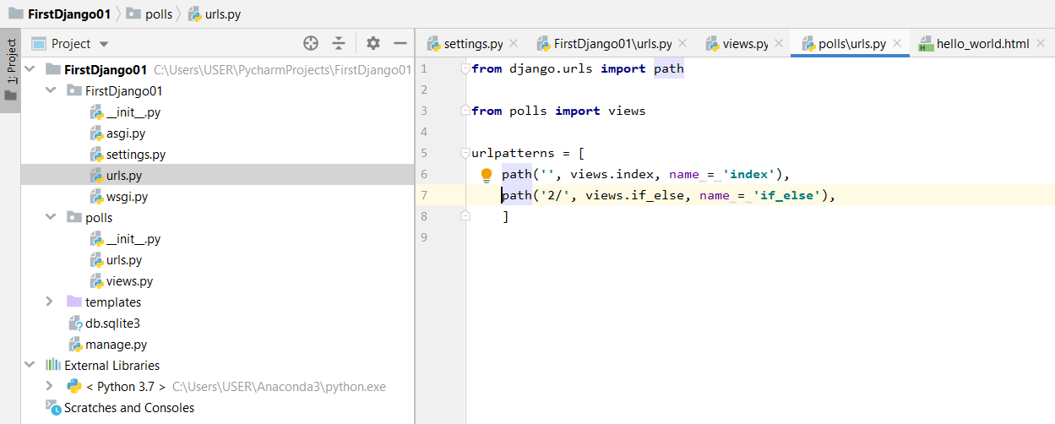
IF/ELSE Example
views.py
urls.py
HTML
We define a new URL ('2/') to request a value when the web browser call the path.
Modify the file "urls.py" in the folder "polls".
from django.urls import path
from polls import views
urlpatterns = [
path('', views.index, name = 'index'),
path('2/', views.if_else, name = 'if_else'),
]

Slide 43
IF/ELSE Example
views.py
urls.py
HTML
<!DOCTYPE html>
<html>
<head>
<meta charset="EUC-KR">
<title>Hello World "IF / ELSE"</title>
</head>
<body>
<h1> IF / ELSE {{ warranty }} </h1>
{% if warranty %}
<p>Your warranty information will be included in the packaging.</p>
{% endif %}
<br/>
{% if warranty %}
<p>Your warranty information will be included in the packaging.</p>
{% else %}
<p> No warranty of your product</p>
{% endif %}
{% if vara > varb %}
<p> {{vara}} is greater than {{varb}}
{% elif vara < varb %}
<p> {{varb}} is greater than {{vara}}
{% else %}
<p> {{varb}} equals to {{vara}}
{% endif %}
</body>
</html>
Add file "hello_if.html" in the folder "templates".
Note: copy all codes below
This HTML file includes the IF, IF/ELSE, and IF/ELIF/ELSE function of Python using Template Loading.

Slide 44
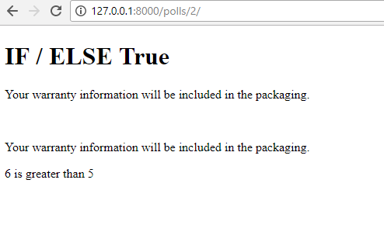
Execute
http://127.0.0.1:8000/polls/2/

Slide 45
Additional: Template Tag (if/else)
The {% if %} tag accepts and, or, or not for testing multiple variables, or to negate a given variable. For example:
Updated code at “Hello_if.html”
Operator | Descriptions
and | Both conditions should be true to result true
not | Negate a given variable
or | Either conditions should be true to result true
{% if vara > 5 and varb < 8 %}
<p> Yes, {{ vara }} is greater than 5 and <br>
{{ varb }} is less than 8 - TRUE </p>
{% else %}
<p> false </p>
{% endif %}

Slide 46
Additional: Template Tag (if/else)
{% if %} tags do NOT allow and and or clauses within the same tag, because the order of logic would be ambiguous. For example, this is invalid:
{% if athlete_list and coach_list or cheerleader_list %}

Slide 47
Additional: Template Tag (if/else)
If you need to combine and and or to do advanced logic, just use nested {% if %} tags, for example:
{% if athlete_list %}
{% if coach_list or cheerleader_list %}
We have athletes, and either coaches or cheerleaders!
{% endif %}
{% endif %}

Slide 48
Template Tag (for)
The {% for %} tag allows you to loop over each item in a sequence.
As in Python’s for statement, the syntax is for X in Y, where Y is the sequence to loop over and X is the name of the variable to use for a particular cycle of the loop.
Each time through the loop, the template system will render everything between {% for %} and {% endfor %}.
For example, you could use the following to display a list of athletes given a variable athlete_list:
<ul>
{% for athlete in athlete_list %}
<li>{{ athlete.name }}</li>
{% endfor %}
</ul>

Slide 49
For-Loop Example
views.py
urls.py
HTML
Include a function "for_loop" in the "views.py" in the folder "polls".
The same as the previous example, we adopt the datetime function.
The function weekday() returns an integer number [0..6] where 0 = Monday, 1 = Tuesday, and so on.
import datetime
def for_loop(request):
weekday = ["Monday", "Tuesday", "Wednesday", "Thursday", "Friday", "Saturday", "Sunday"]
today = datetime.datetime.today().weekday()
#today = datetime.datetime(2018, 3, 26)
#today = today.weekday()
temp = loader.get_template('hello_for.html')
context = {
'today' : today,
'weekday' : weekday,
}
return HttpResponse(temp.render(context, request))

Slide 50
For-Loop Example
views.py
urls.py
HTML
Add a path in the file "urls.py" in folder "polls"
from django.urls import path
from polls import views
urlpatterns = [
path('', views.index, name = 'index'),
path('2/', views.if_else, name = 'if_else'),
path('3/', views.for_loop, name = 'for_loop'),
]

Slide 51
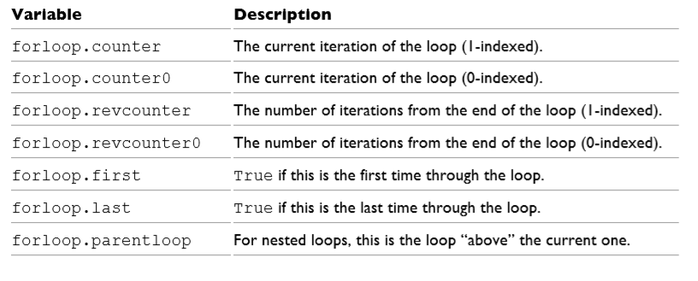
For-Loop Example
views.py
urls.py
HTML
<!DOCTYPE html>
<html>
<head>
<meta charset="EUC-KR">
<title>Hello World "For"</title>
</head>
<body>
<h1> For Loop {{ today }} </h1>
{% for i in '0123456789' %}
{{ forloop.counter0 }}
{% endfor %}
<br/>
{% for i in 'xxxxxxxxxxxxxxxxxxxxxxxxxx' %}
{{ forloop.counter }}
{% endfor %}
<br/>
{% for i in 'xxxxxxxxxxxxxxxxxxxxxxxxxx' %}
{{ forloop.revcounter }}
{% endfor %}
<br/>
{% for i in 'xxxxxxxxxxxxxxxxxxxxxxxxxx' %}
{{ forloop.revcounter0 }}
{% endfor %}
<br/>
{% for i in 'xxxxxxxxxxxxxxxxxxxxxxxxxx' %}
{{ forloop.first }}
{% endfor %}
<br/>
{% for i in 'xxxxxxxxxxxxxxxxxxxxxxxxxx' %}
{{ forloop.last }}
{% endfor %}
{% for i in weekday%}
<p> {{i}}</p>
{% endfor %}
<p> ---------------- </p>
{% for i in weekday%}
{% for j in 'xxxx' %}
{{i}}
{{forloop.parentloop.counter}}
<!-- {{forloop.counter}} -->
{% endfor %}
<br/>
{% endfor %}
</body>
</html>
File "hello_for.html" in folder "templates“
Note: copy all codes below

Slide 52
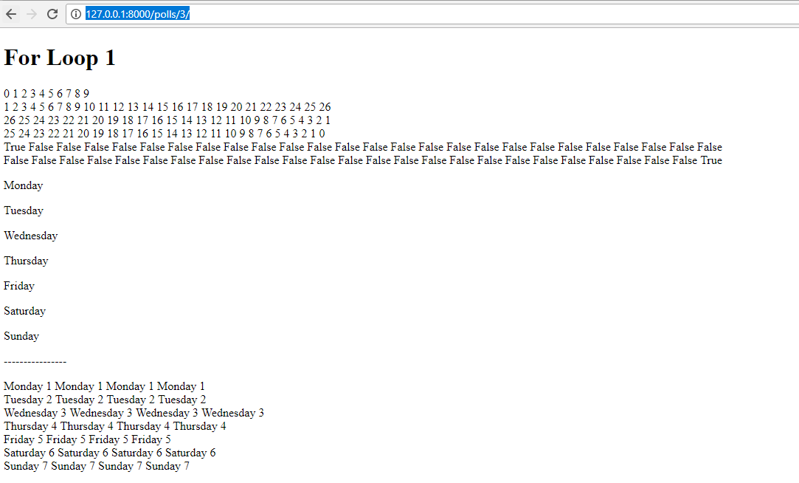
Execute
http://127.0.0.1:8000/polls/3/

Slide 53
Template Tag (for)
Tag | Description
forloop.counter | set to an integer representing the number of times the loop has been entered.
forloop.counter0 | like forloop.counter, except it’s zero-indexed. Its value will be set to 0 the first time through the loop.
forloop.revcounter | set to an integer representing the number of remaining items in the loop. The first time through the loop, forloop.revcounter will be set to the total number of items in the sequence you’re traversing. The last time through the loop, forloop.revcounter will be set to 1.
forloop.revcounter0 | like forloop.revcounter, except it’s zero-indexed. The first time through the loop, forloop.revcounter0 will be set to the number of elements in the sequence minus 1. The last time through the loop, it will be set to 0.
forloop.first | a Boolean value set to True if this is the first time through the loop. This is convenient for special casing.
forloop.last | a Boolean value set to True if this is the last time through the loop. A common use for this is to put pipe characters between a list of links.
forloop.parentloop | a reference to the forloop object for the parent loop, in case of nested loops.

Slide 54
Additional: Template Tag (for)
It’s possible to nest {% for %} tags:
There is no support for “breaking out” (break) of a loop before the loop is finished.
If you want to accomplish this, change the variable you’re looping over so that it includes only the values you want to loop over.
Similarly, there is no support for a “continue” (continue) statement that would instruct the loop processor to return immediately to the front of the loop.
{% for country in countries %}
<h1>{{ country.name }}</h1>
<ul>
{% for city in country.city_list %}
<li>{{ city }}</li>
{% endfor %}
</ul>
{% endfor %}

Slide 55
Template Tag (ifequal/ifnotequal)
The {% ifequal %} tag compares two values and displays everything between {% ifequal %} and {% endifequal %} if the values are equal.
Just like {% if %}, the {% ifequal %} tag supports an optional {% else %}:

Slide 56
IFEqual Example
views.py
urls.py
HTML
Include the function "ifequal_func" in the file "views.py" in the folder "polls".
def ifequal_func(request):
vara = 6
varb = 5
temp = loader.get_template('hello_ifequal.html')
context1 = {
'vara' : vara,
'varb' : varb,
}
return HttpResponse(temp.render(context1, request))

Slide 57
IFEqual Example
views.py
urls.py
HTML
Append path ('4/') in the 'urls.py' in the folder 'polls'
from django.urls import path
from polls import views
urlpatterns = [
path('', views.index, name = 'index'),
path('2/', views.if_else, name = 'if_else'),
path('3/', views.for_loop, name = 'for_loop'),
path('4/', views.ifequal_func, name = 'ifequal_function'),
]

Slide 58
IFEqual Example
views.py
urls.py
HTML
Create "hello_ifequal.html" in the folder "templates".
<!DOCTYPE html>
<html>
<head>
<meta charset="EUC-KR">
<title>Hello World "IFEQUAL"</title>
</head>
<body>
<h1> IFEQUAL </h1>
{% ifequal vara varb %}
<p>{{vara}} equals to {{varb}}</p>
{% endifequal %}
{% ifnotequal vara varb %}
<p>{{vara}} is not equal to {{varb}}</p>
{% endifnotequal %}
</body>
</html>

Slide 59
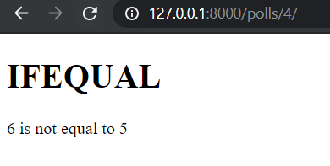
Execute
http://127.0.0.1:8000/polls/4/

Slide 60
Summary
We learnt the Python and Django Basic using PyCharm environment
Next, we will learn more about Django Template

